Slide 1
Capstone Design
Team 3
20163704
20161344
20164245
Park JuHyeon
Heo JeongWoo
Hong Jin

Slide 2
Contents
1.
Feedback
Progress
Schedule
Q&A
2.
3.
4.

Slide 3



♥
Project Introduction
Smoothie
person
Input
Output

Slide 4
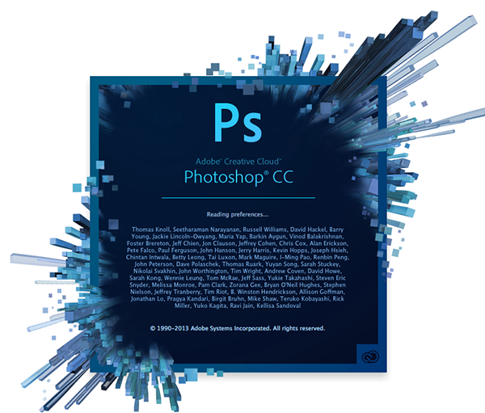

♥
Project Introduction
What’s the difference?

Slide 5
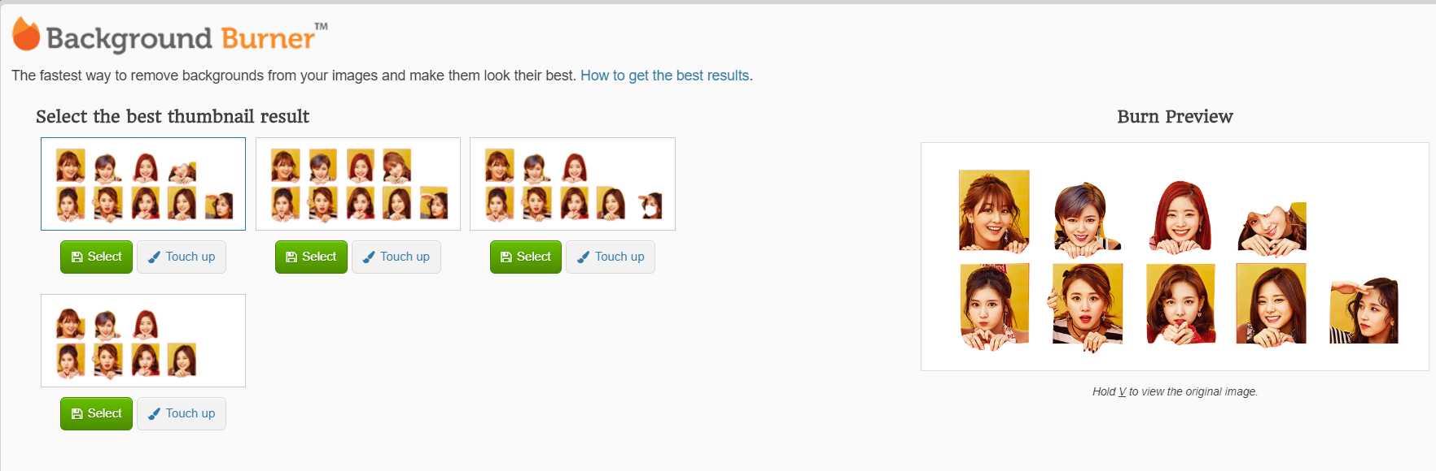
♥
Project Introduction

Slide 6
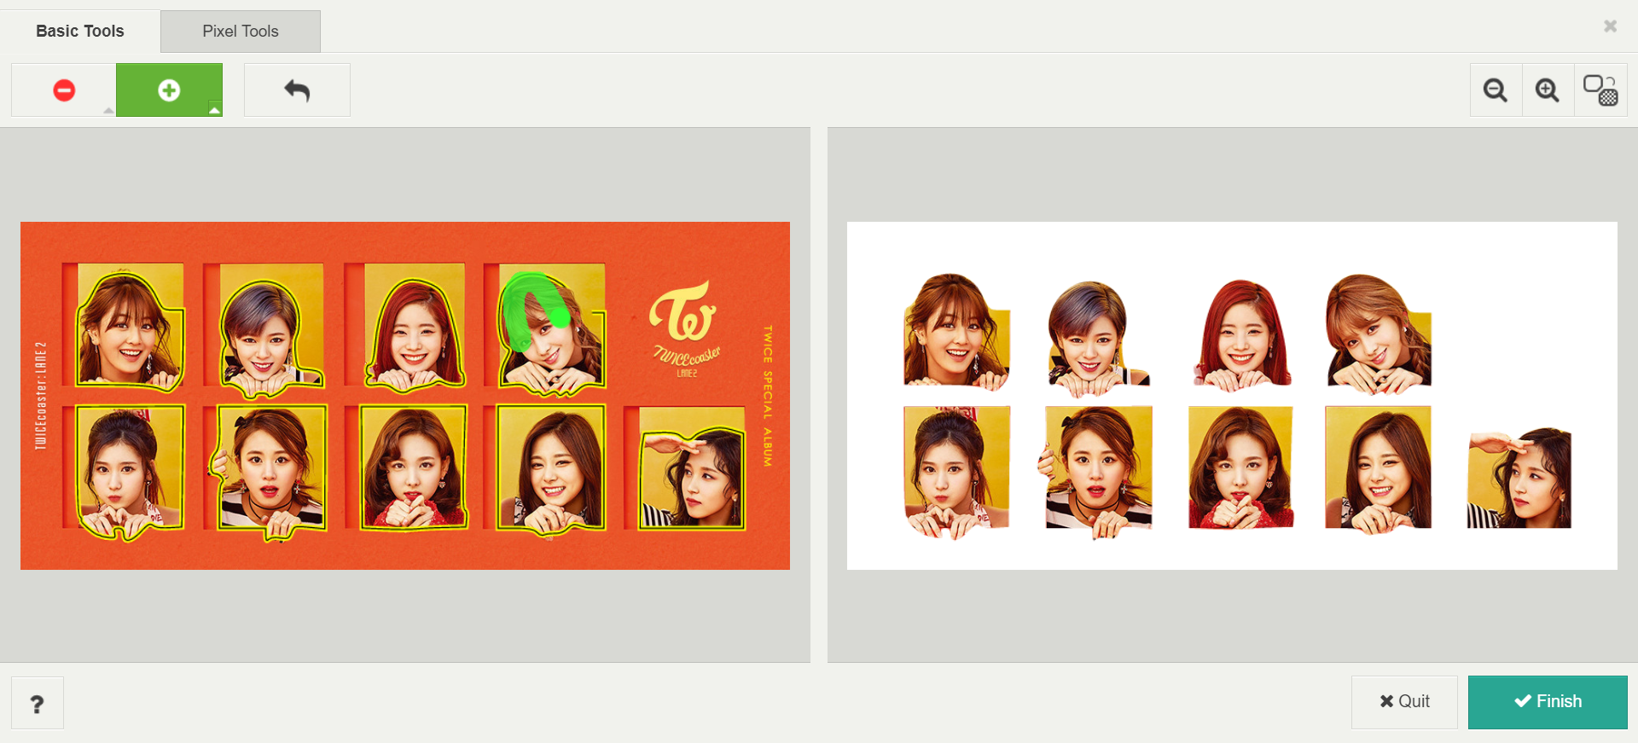
♥
Project Introduction

Slide 7
♥
Project Introduction
What’s the difference?

Slide 8
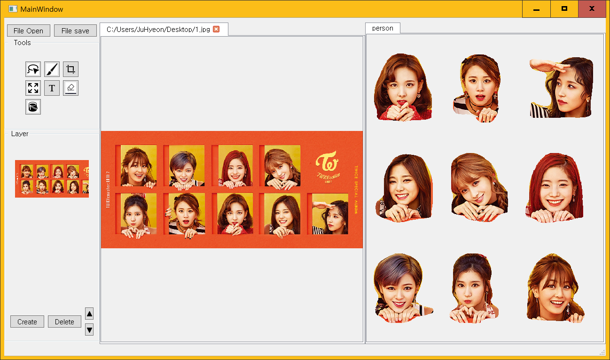
♥
Project Introduction

Slide 9
1.
Q&A Feedback

Slide 10
1
Q&A Feedback
Feedback
Zoom In / Zoom out
> We are implementing this function!
> Ctrl + wheel
Memory waste
> We planned not to waste memory by using certain keywords. And we think it is hard to adjust to all users.

Slide 11
1
Q&A Feedback
Feedback
Qlabel Layer
> We use Qlabel only at layer mark.
> We maintain the inner information as vector<Qpixmap*>

Slide 12
2.
Progress

Slide 13
2.1
Lasso Function

Slide 14

2
Progress
Pyinstaller – Park Juhyeon
Make .Py to .EXE
Pyinstaller

Slide 15
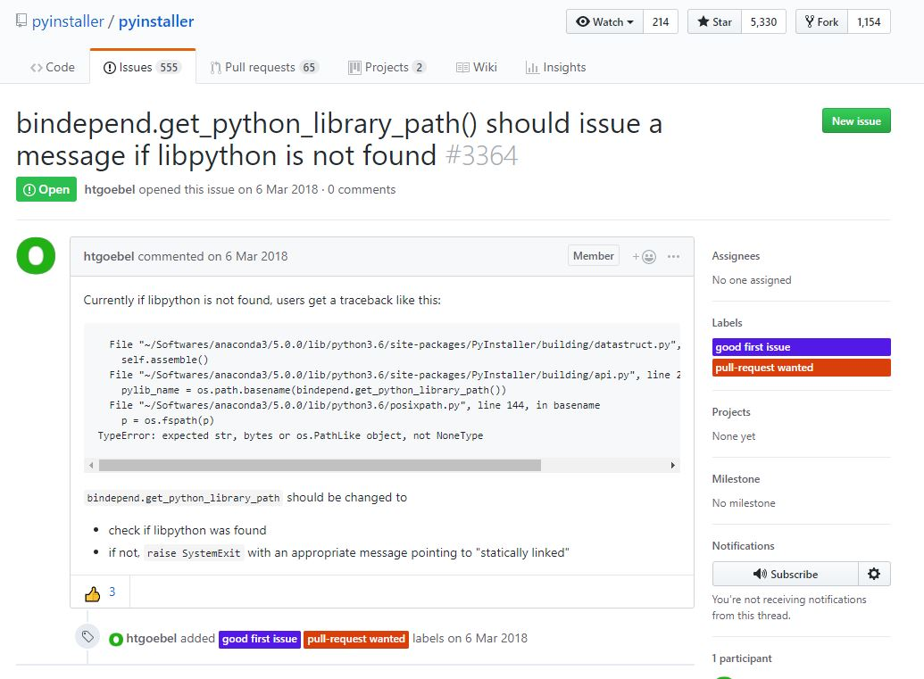
2
Progress
Pyinstaller – Park Juhyeon
We judged to be an error between python and pyinstaller
Last Week….
We find that libpython is needed, but we have no solution about this

Slide 16
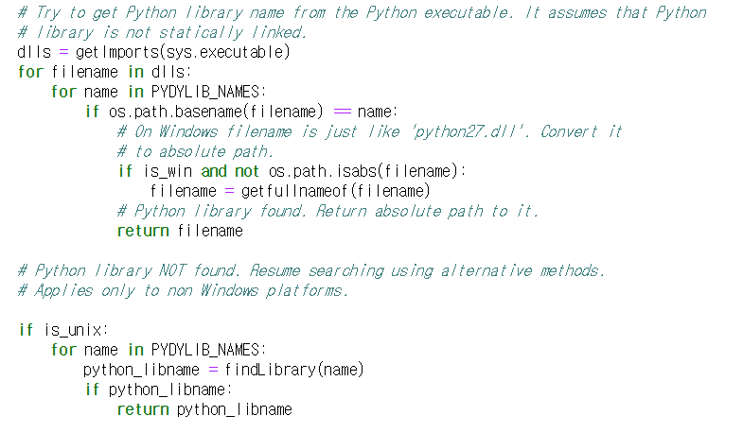
2
Progress
Pyinstaller – Park Juhyeon
We solve this problem to modify PyInstaller/bindepend.py
->Directively path setting

Slide 17
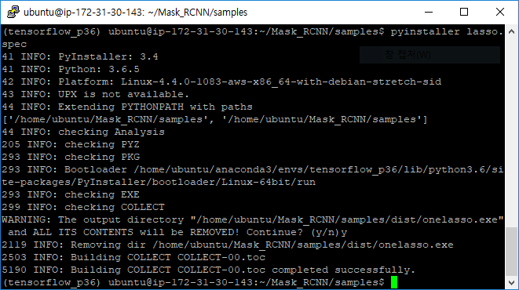
2
Progress
Pyinstaller – Park Juhyeon
Completed successfully,
But it has Runtime errors
“Module not Find Error”

Slide 18
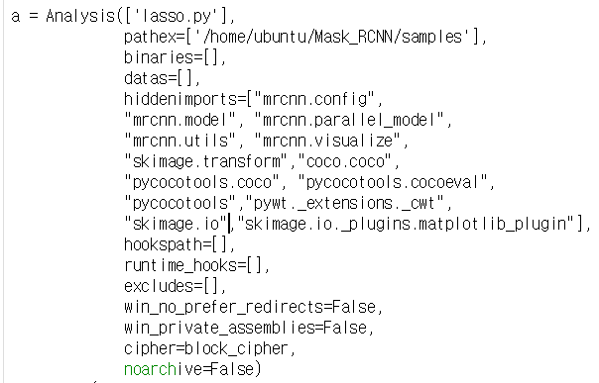
2
Progress
Pyinstaller – Park Juhyeon
Modify .spec files -> hidden imports
-> this problem is one of common error between python and pyinstaller

Slide 19
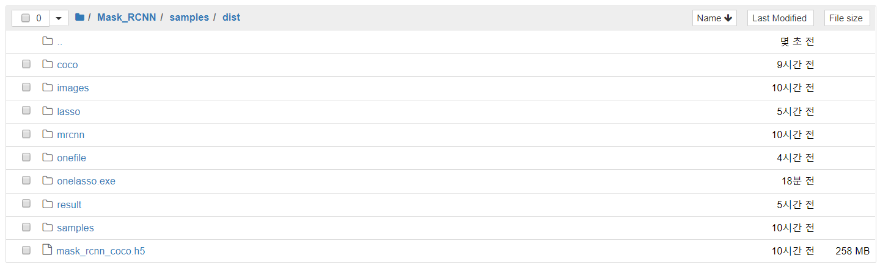
2
Progress
Pyinstaller – Park Juhyeon
Finally completely execute .exe file
Easy to Execute -> ./lasso.exe

Slide 20
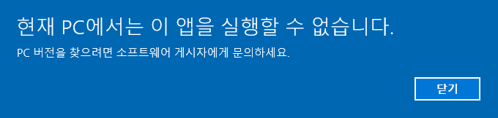
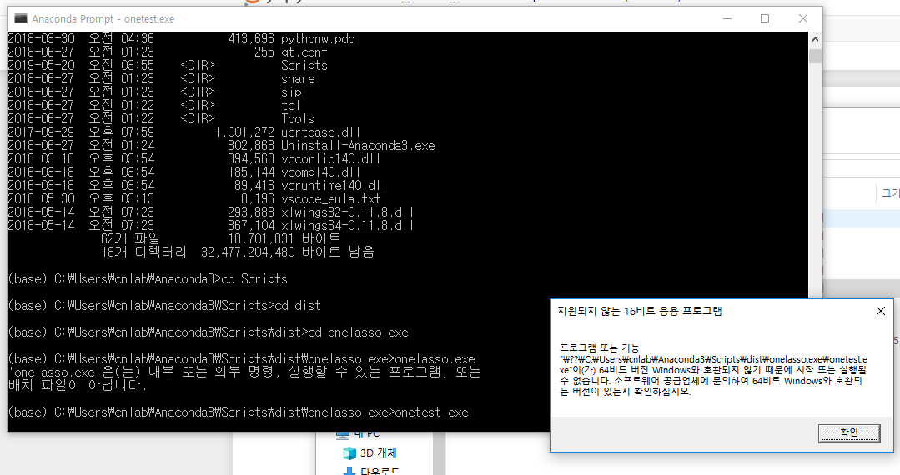
2
Progress
Pyinstaller – Park Juhyeon
Linux version can’t execute in Windows……
(window is x64 processor)

Slide 21

2
Progress
Pyinstaller – Park Juhyeon
We decide to make Windows envs, too..
Duplicate environments from Ubuntu server

Slide 22
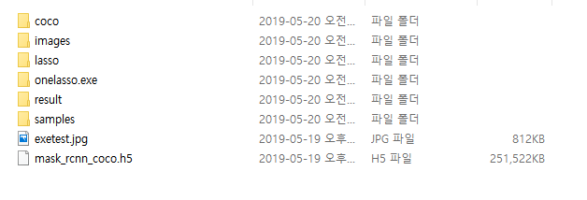

2
Progress
Pyinstaller – Park Juhyeon
And Finally make .exe to use PyInstaller in Windows

Slide 23
2.2
QT

Slide 24
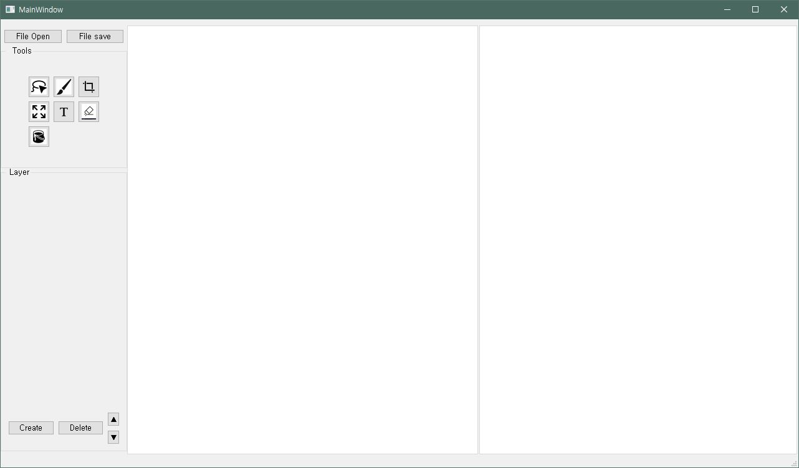
2
Progress
Layer Function – Heo Jeong Woo
Layer Function

Slide 25
2
Progress
Layer Function – Heo Jeong Woo
Layer Window
Users can see what layers are activate

Slide 26
2
Progress
Layer Function – Heo Jeong Woo
Layer Buttons
User can create/delete the layers above.
User can change layer’s order.

Slide 27
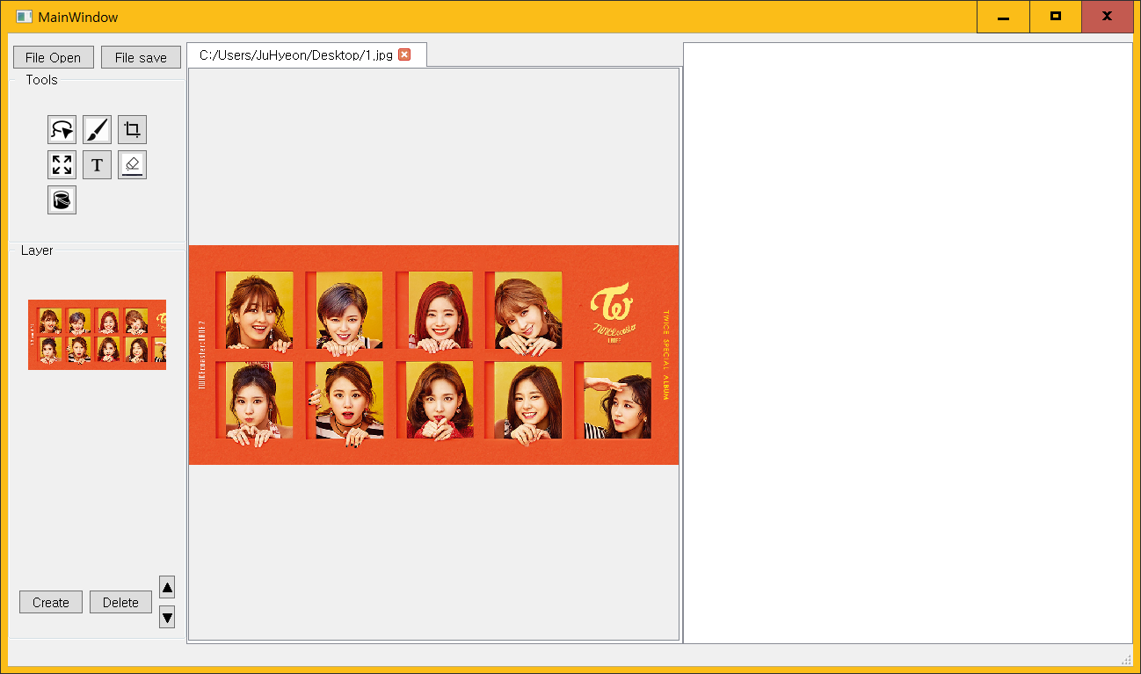
2
Progress
Layer Function – Heo Jeong Woo

Slide 28
2
Progress
Layer Function – Heo Jeong Woo

Slide 29
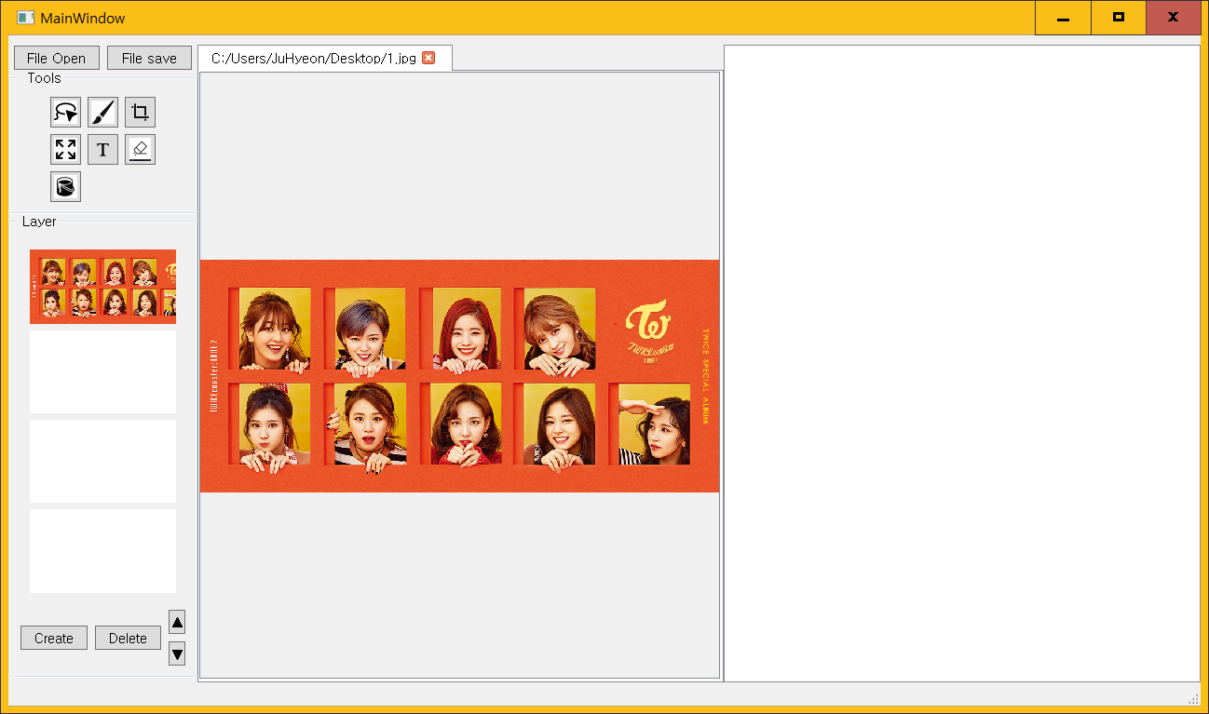
2
Progress
Layer Function – Heo Jeong Woo

Slide 30
2
Progress
Layer Function – Heo Jeong Woo

Slide 31
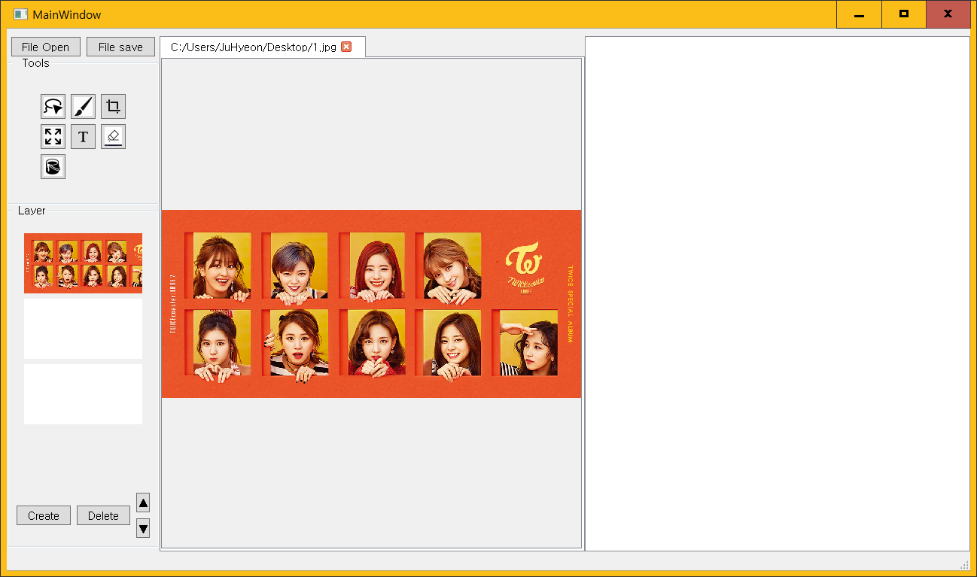
2
Progress
Layer Function – Heo Jeong Woo

Slide 32
2
Progress
Layer Function – Heo Jeong Woo

Slide 33
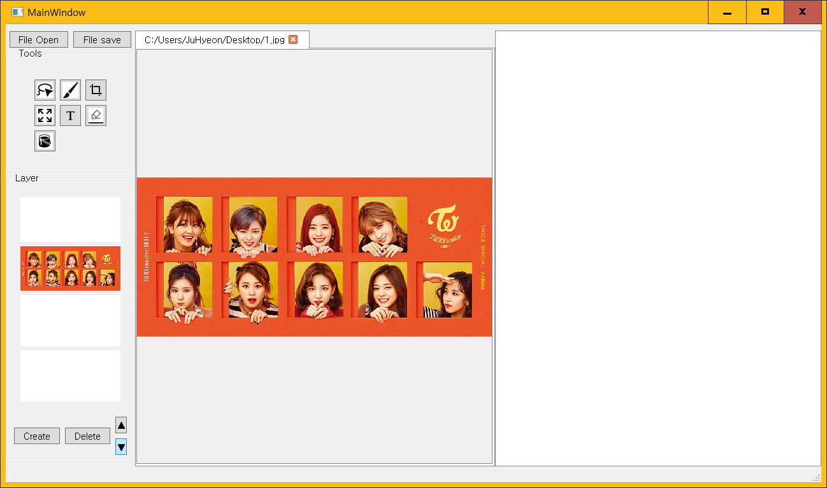
2
Progress
Layer Function – Heo Jeong Woo

Slide 34
2
Progress
Drawing Function – Heo Jeong Woo
Drawing Function
It has a problem with Layer buffer.

Slide 35
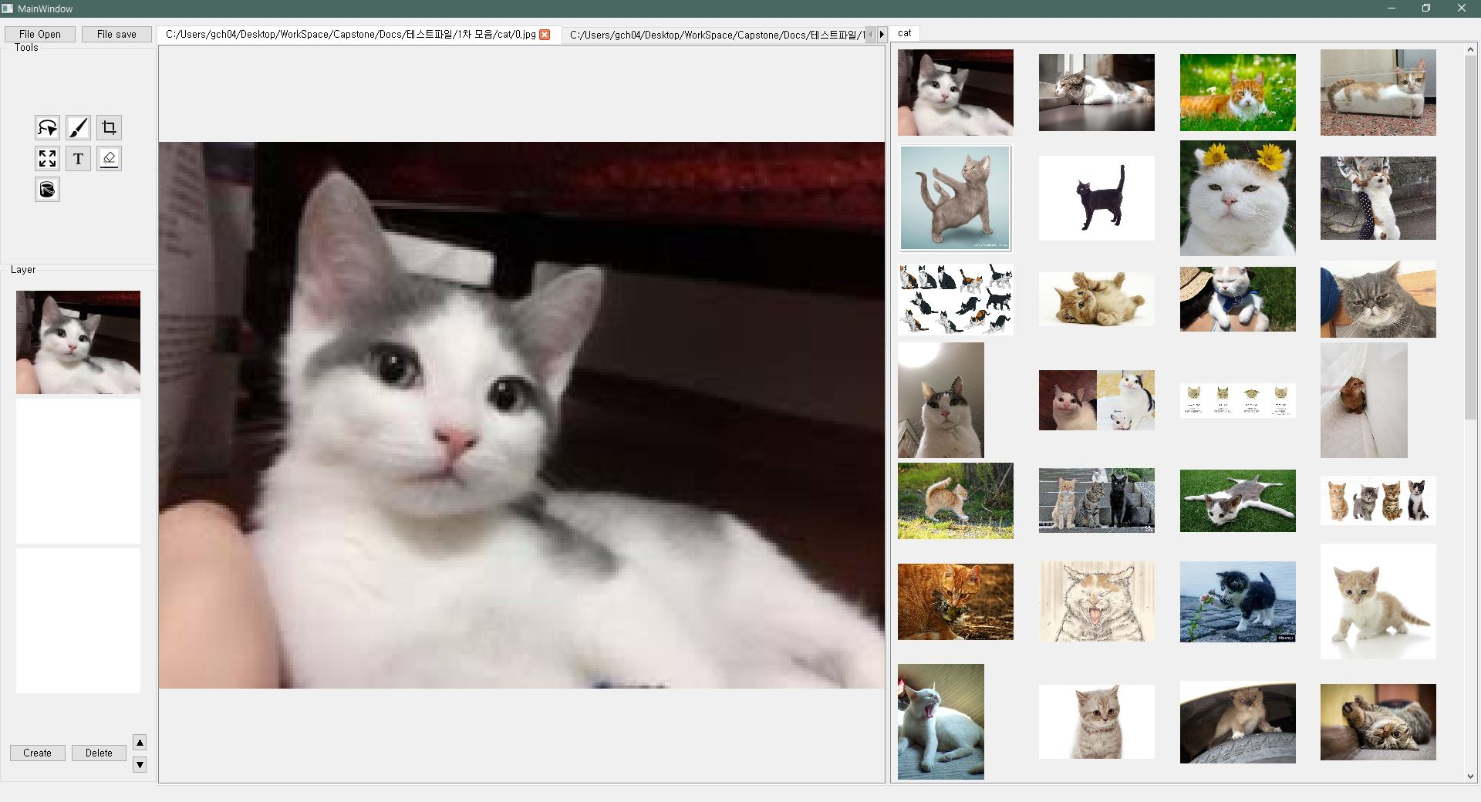
2
Progress
Subtap page – Heo Jeong Woo
Fix image grid size
Fix the image grid size 150*150.
User can see all images with scroll.

Slide 36
2
Progress
Subtap page – Heo Jeong Woo

Slide 37

2
Progress
Lasso + Subtap – Hong Jin
Result Images
Pyinstaller
Folder

Slide 38
2
Progress
Lasso + Subtap – Hong Jin

Slide 39
2
Progress
Lasso + Subtap – Hong Jin

Slide 40
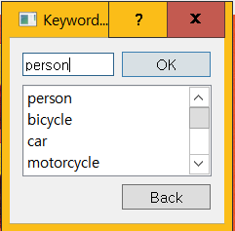
2
Progress
Lasso + Subtap – Hong Jin

Slide 41
2
Progress
Lasso + Subtap – Hong Jin

Slide 42
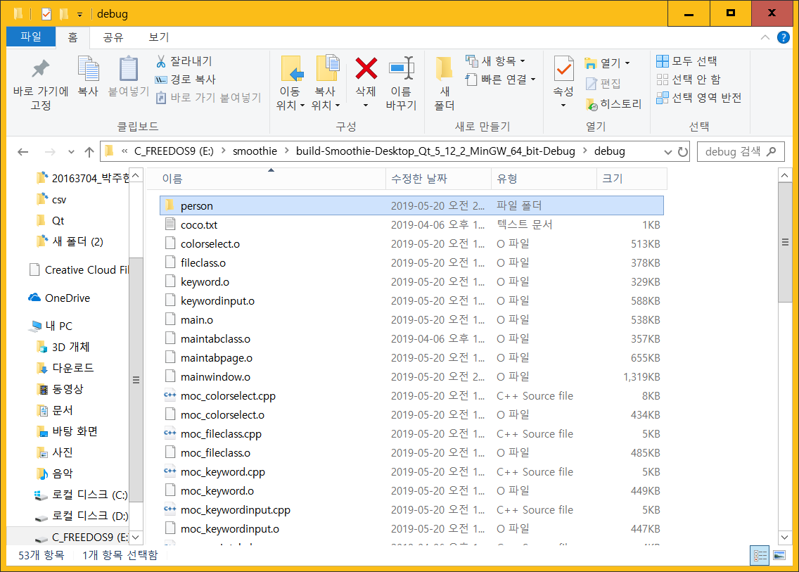
2
Progress
Lasso + Subtap – Hong Jin

Slide 43
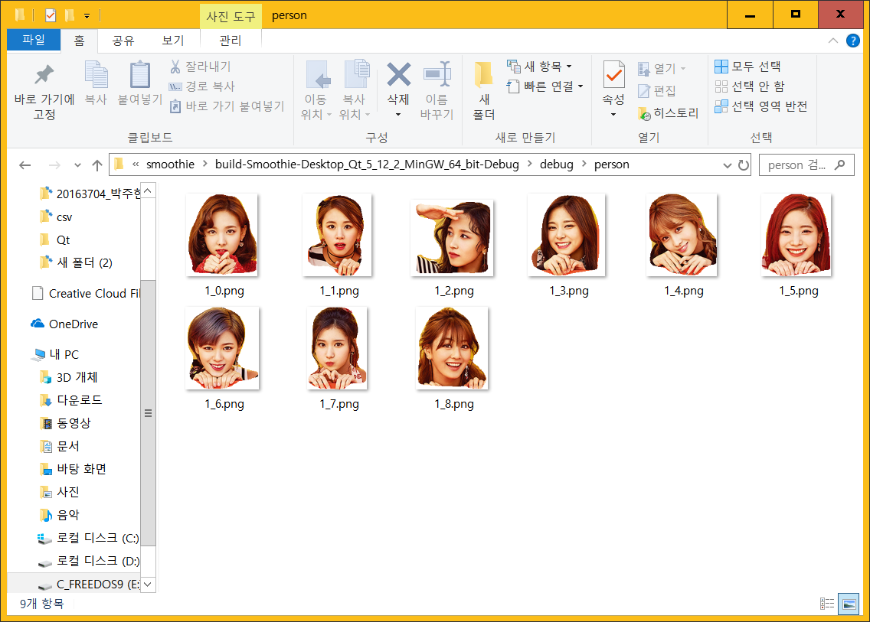
2
Progress
Lasso + Subtap – Hong Jin

Slide 44
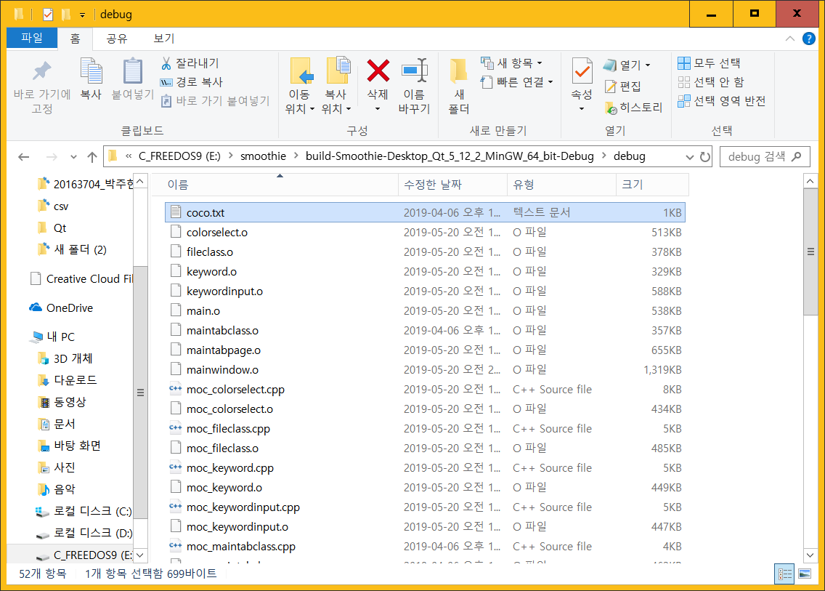
2
Progress
Lasso + Subtap – Hong Jin

Slide 45
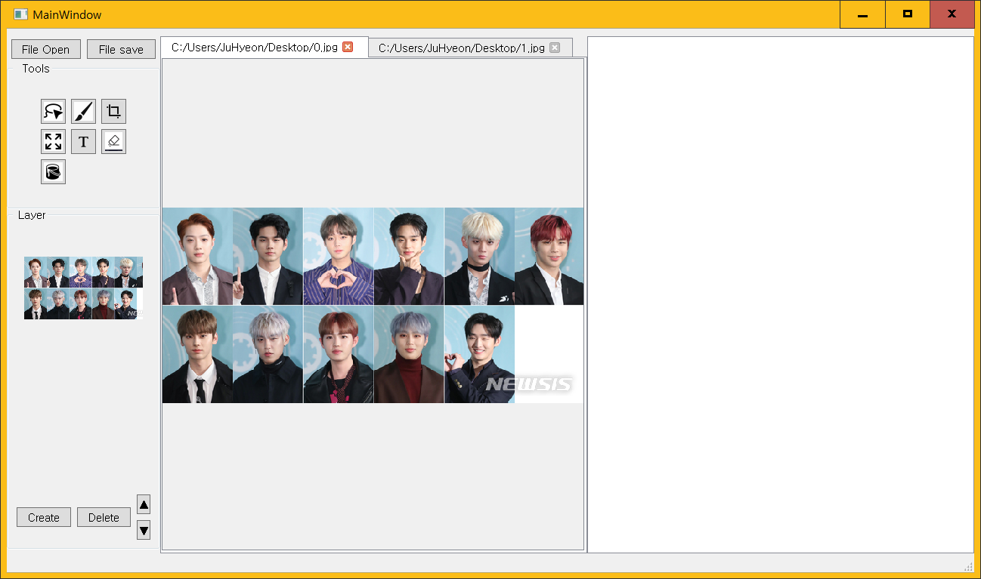

2
Progress
Lasso + Subtap – Hong Jin

Slide 46
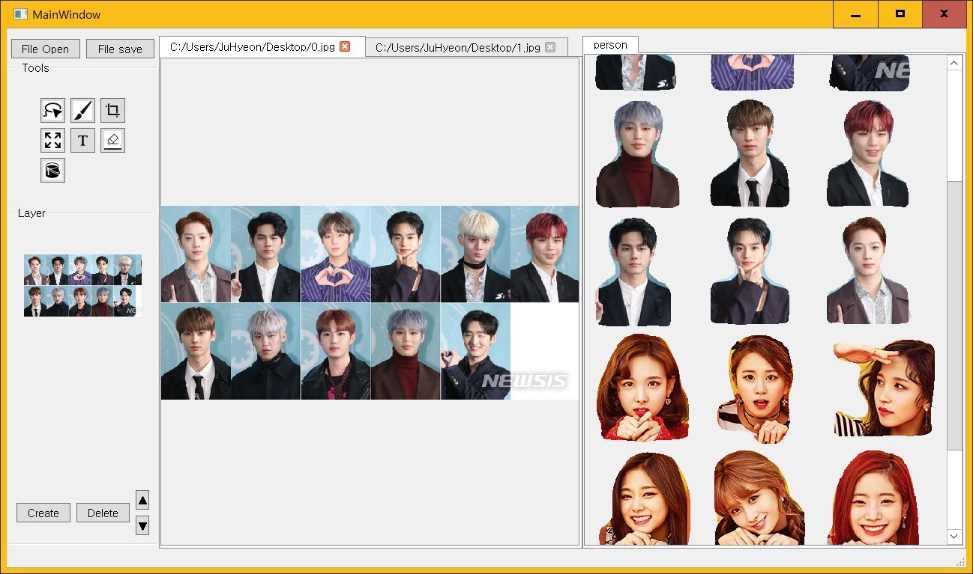
2
Progress
Lasso + Subtap – Hong Jin

Slide 47
3.
Schedule

Slide 48
3
Schedule
 | March |  |  | April |  |  |  |  | May |  |  |  | June
Week | 11 | 18 | 25 | 1 | 8 | 15 | 22 | 29 | 6 | 13 | 20 | 27 | 3 | 10 | 17
Data survey
Collect Datasets
Detection Model
Segmentation Model
Lasso Function
QT basic UI
Prepare Midterm Demo
Function & QT Details
Test and Debugging
Prepare Final Demo
Writing manuals, report
Midterm Presentation
Midterm Exam
Final Presentation

Slide 49
3
Schedule
Progress | Park Juhyeon | Hong Jin | Heo Jung Woo
This Week Proceeding | Make exe file with pyinstaller | Modify python code with user input | Layer Function
 | Test in Linux envs. | Store Lasso function’s result images | Subpagetap function
 | Test in Window envs. | Connect qt with exe file | Drawing function

Slide 50
4.
Q&A

